Slide 1
Data Warehouse Concepts
Day 1 Venkat M

Slide 2
Agenda
Data warehousing and architecture
Data Marts
Data Processing (OLTP,DSS,OLCP & OLAP)
Data Cubes
Types of OLAP
Notes:
HOLAP:

Slide 3
What is a Data Warehouse?
A Data Warehouse Is A Structured Repository of Historic Data. It Is Developed in an Evolutionary Process By Integrating Data From Non-integrated Legacy Systems.
It Is Usually:
Subject Oriented : Organized around subjects such as sales,product,customer.
Integrated : Constructed by integrating multiple heterogeneous sources. For example RDMS, Flat Files
Time Variant: Provides information from historical perspective and data have an element of time.
Non-volatile: Data once recorded cannot be updated
Notes:
Data warehouse term was coined by Bill Immon in 1990.

Slide 4
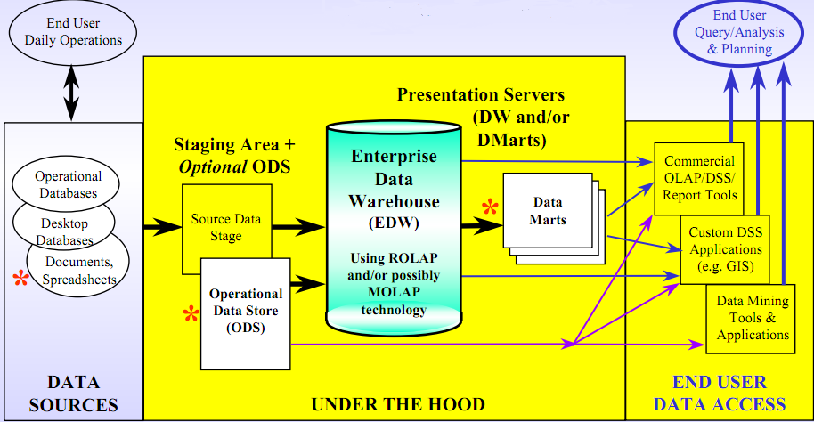
Data Warehousing Architecture
Notes:
Data Mart: A data structure that is optimized for access. It is designed to facilitate end-user analysis of data. It typically supports a single, analytic application used by a distinct set of workers.
Staging Area: Any data store that is designed primarily to receive data into a warehousing environment.
Operational Data Store: A collection of data that addresses operational needs of various operational units. It is not a component of a data warehousing architecture, but a solution to operational needs.
OLAP (On-Line Analytical Processing): A method by which multidimensional analysis occurs.
Decision Support System(DSS):

Slide 5
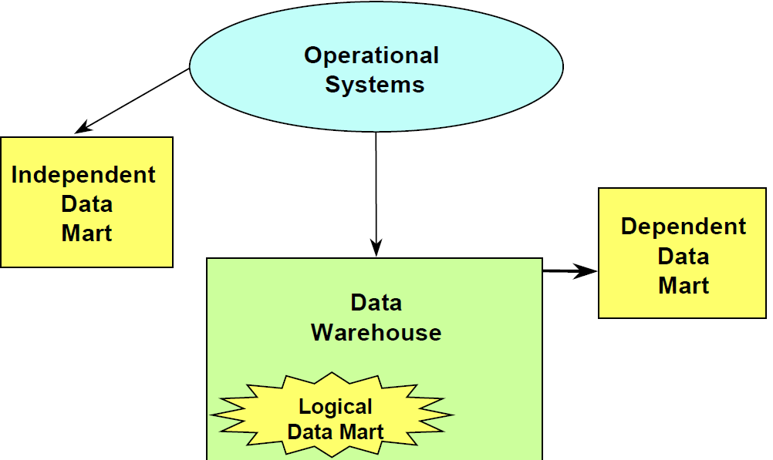
Data Mart
A data mart is a special purpose subset of enterprise data for a particular function or application (department, region, function, etc.) It may contain detail or summary data or both.
Data mart types:
• Independent: created directly from operational systems to a separate physical data store.
• Logical: exists as a subset of existing data warehouse.
• Dependent: created from data warehouse to a separate physical data store.
Notes:
Independent Data Mart
Pro
Easy to implement
Can eventually become a DW
Con
Not an enterprise-wide solution
Costly as more DMs are added
More than one version of the truth
Limits amount of historical data
Data transformations needed
Doesn’t do “what if” queries
Logical Data Mart
Pro
Single version of the truth
No historical data limits
Allows drill downs, trend analysis
No transformations needed
Con
Less physical control over data
Not pre-aggregated, sorted or dimensionalized
Can use views, summary tables
Dependent Data Mart
Pro
All advantages of Logical DM
Allows for physical control over data
Con
Additional movement of data is necessary
Some transformation may be needed

Slide 6
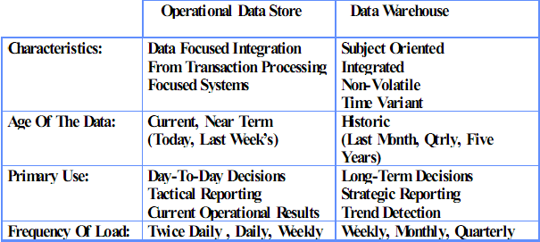
ODS Vs. Data Warehouse

Slide 7
ETL (Extract, Transform, Load)
EXTRACT: Data Extraction from Data Sources
Diverse and uncoordinated
Different platforms in many locations
Multiple file formats and data types
TRANSFORM: Staging Area for Data Cleansing/Transformation
Clean, prune, combine, reconcile duplicates, Translate, standardize
A back room operation NOT a place for “public” accessibility
LOAD: Presentation Platform
access by decision makers and others
Presentation servers are Subject oriented and User Community driven

Slide 8
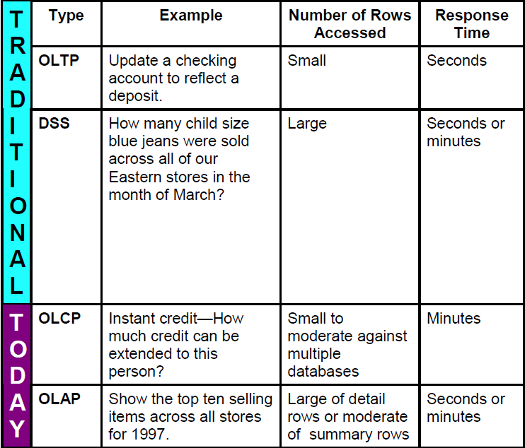
Data Processing
Notes:
OLTP : On-line Transaction processing. (it involves updating of one or two rows ex: ATM transaction)
DSS : Decision Support System.(it reads millions even billions of records for analyzing trends)
OLCP : On-line Complex processing.(it often takes a minute and utilize moderate no. of rows from other databases ex: Credit balance checking)
OLAP : On-line Analytical processing.(it is used to bring out top 10 products being sold or worst top 10 product not sold)

Slide 9
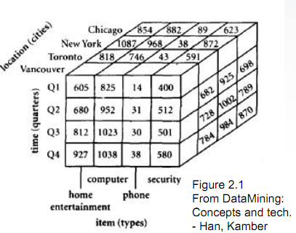
DATA CUBE & OLAP OPERATIONS
Data cube is thus a n - dimensional data model
This multi-dimensional data can be represented using a data
cube as shown below
OLAP OPERATIONS
Roll-up: Performs aggregation on a data cube, either by climbing up a concept hierarchy for a dimension or by dimension reduction
Drill-down: Can be realized by either stepping down a concept hierarchy for a dimension or introducing additional dimensions
Slice and Dice: Slice performs a selection on one dimension of the given cube, resulting in a sub cube Dice defines a subcube by performing a selection on two or more dimensions
Pivot (rotate): It’s a visualization operation that rotates the data axes in view in order to provide an alternative presentation of the data
4 x 4 x 4
Notes:
It is another conceptual method for increasing query response time.

Slide 10
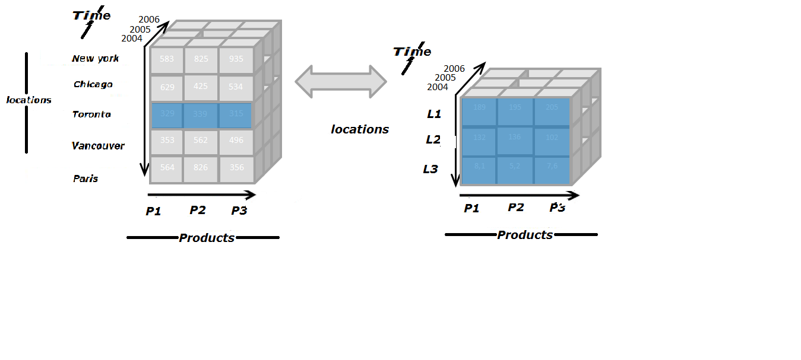
OLAP Operations
Drill-down
Notes:
Drill down

Slide 11
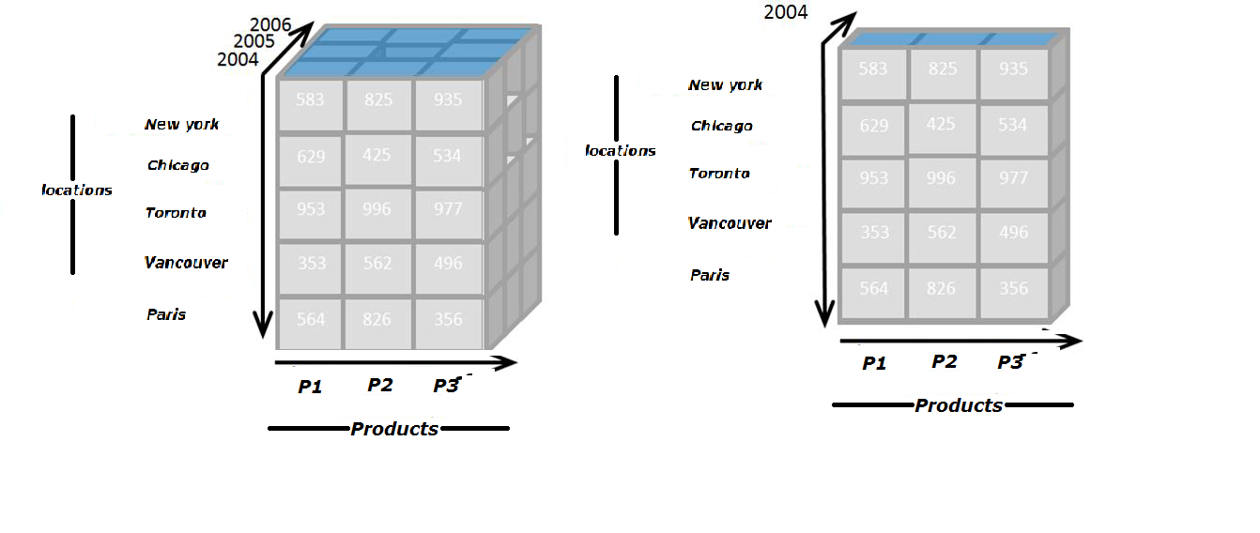
OLAP Operations
Slice
Notes:
Slicing

Slide 12
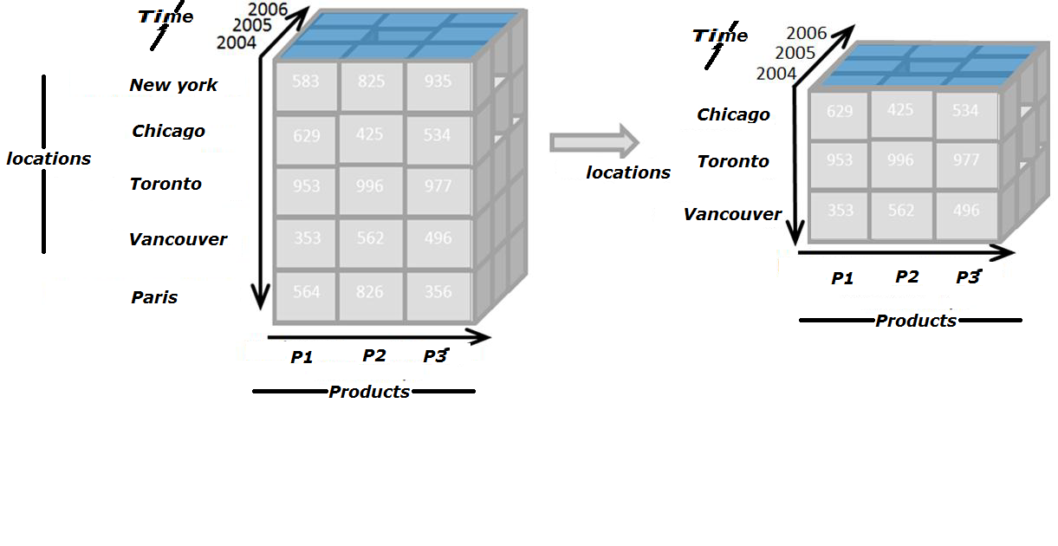
OLAP Operations(Cont..)
Dice
Notes:
dicing

Slide 13
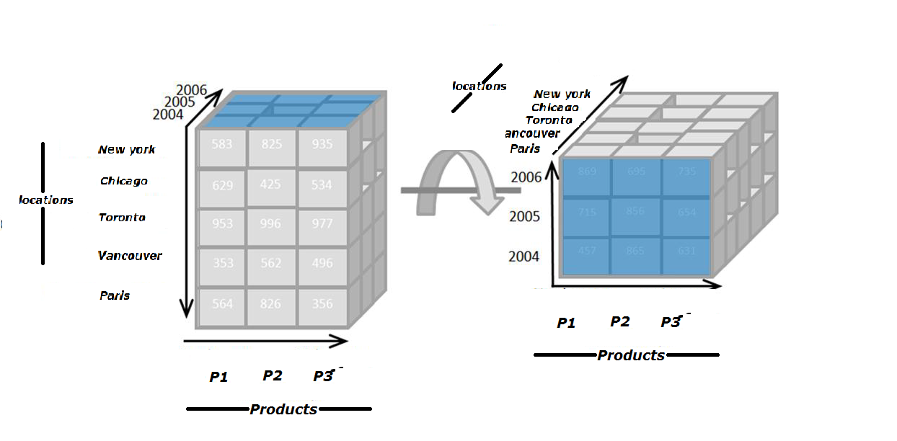
OLAP Operations(Cont..)
Pivot (rotate)
Notes:
Pivoting

Slide 14
TYPES OF OLAP
ROLAP
Data stored in the relational database
Can handle large amounts of data
Can leverage functionalities inherent in the relational database
Performance can be slow
Limited by SQL functionalities
MOLAP
Data is stored in a multidimensional cube
Excellent performance
Can perform complex calculations
Limited in the amount of data it can handle
Requires additional investment
Notes:
ROLAP: Relational online analytical process
MOLAP: Multidimensional OLAP.

Slide 15
TYPES OF OLAP(Cont..)
HOLAP
Combine ROLAP and MOLAP technology
Benefits from greater scalability of ROLAP
Benefits from faster computation of MOLAP
HOLAP servers may allow large volumes of detail data to be stored in a relational database, while aggregations are kept in a separate MOLAP store
Notes:
HOLAP:

Slide 16
Re cap
Data warehousing and architecture
Data Marts
Data Processing (OLTP,DSS,OLCP & OLAP)
Data Cubes
Types of OLAP
Notes:
HOLAP:

Slide 17
Dimensional Modeling
Notes:
HOLAP:

